Slide 1
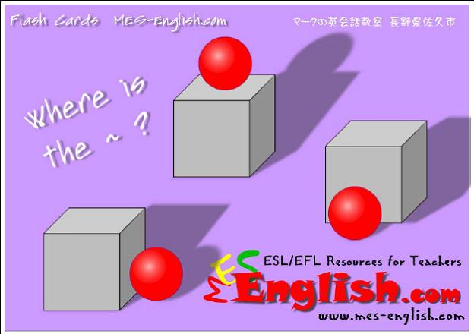

Slide 2
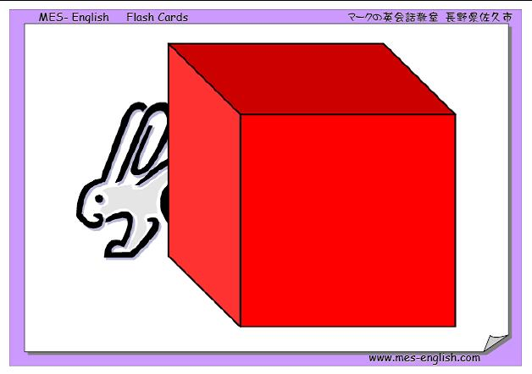
behind

Slide 3
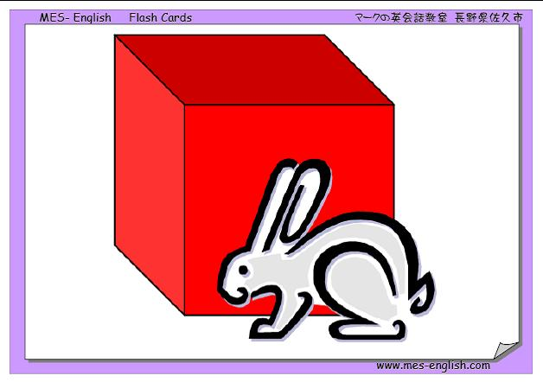
In Front of

Slide 4
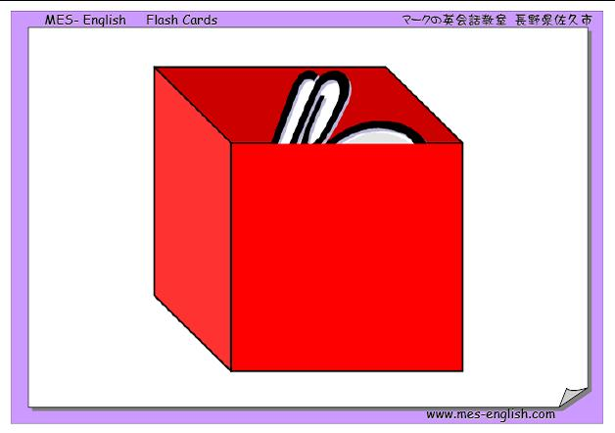
In

Slide 5
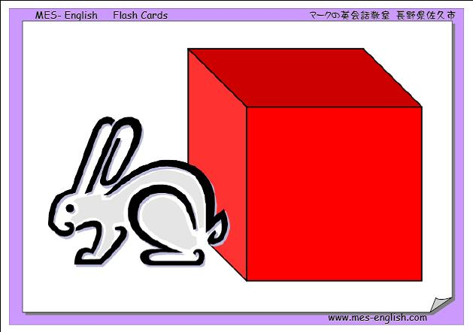
Next to

Slide 6
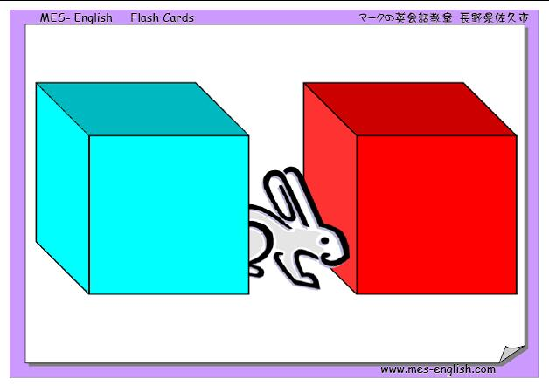
Between

Slide 7
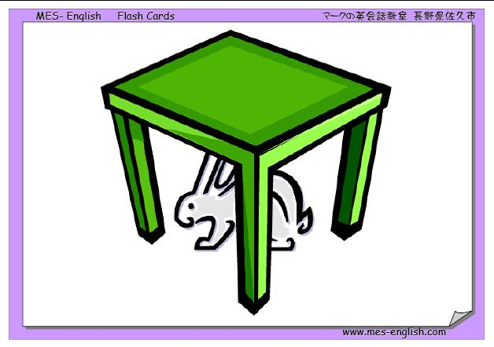
Under

Slide 8
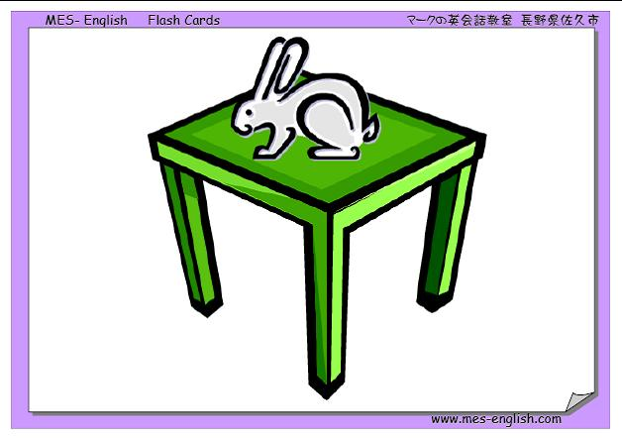
On

Slide 9
The ball is going…
Across
the bridge

Slide 10
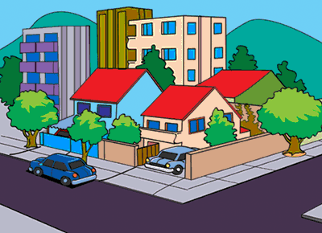
The blue car is in front of the pink house. It is parked on the street.
The pink house is on the corner of Yuka Street and Plaza Avenue
The blue house is next to the pink house.

Slide 11
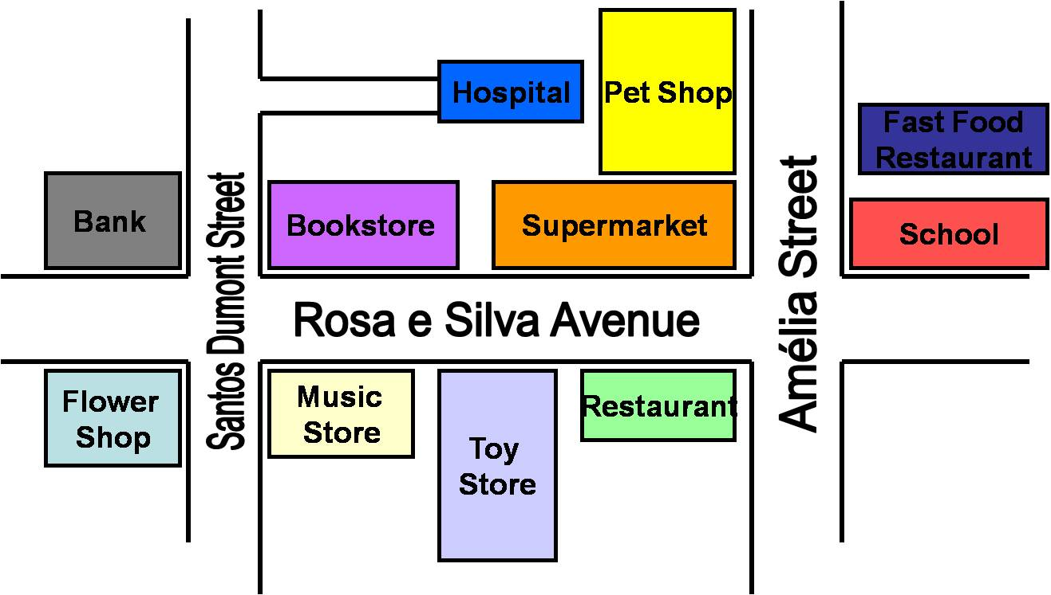
The toy store is on Rosa e Silva Avenue. It’s in the middle of the block.
The music store is on the corner of Santos Dumont Street and Rosa e Silva Avenue
The toy store is between the music store and the restaurant.
The fast food restaurant is across from the pet shop

